Slide 1
Mechanical Stabilization of
Rigid PVC Compositions

Slide 2
Mechanical Stabilization of Rigid PVC Compositions
Thomas C. Pedersen & Robert R. Kwapisz, Jr.
Rheogistics LLC
Picayune, MS USA

Slide 3
PPI TR-2 PVC Pipe Formulation
Ingredient Usage Leve
PVC Resin 100.0 parts
Tin Stabilizer 0.30 – 1.00 phr
Paraffin Wax 0.60 – 1.50 phr
Polyethylene Wax 0.00 – 0.30 phr
Calcium Stearate 0.40 – 1.50 phr
Calcium Carbonate 0.00 – 5.00 phr
Titanium Dioxide 0.50 – 3.00 phr
Process Aid 0.00 – 2.00 phr

Slide 4
Rigid PVC Lubricants
Define rheology and control fusion.
Allow the compound to be adjusted to the process.
The keys to better rigid PVC products and processing
Prevent rigid PVC from degrading when heated and sheared

Slide 5
Rigid PVC Lubricants
Paraffin waxes have been used for more than 40 years to lubricate rigid PVC.
Large volume rigid PVC applications using paraffin waxes as the primary lubricant include:
PVC Pipe
Vinyl Siding
Vinyl Windows
PVC Fencing
PVC Boards

Slide 6
Typical Rigid PVC Lubricant System
Paraffinic Hydrocarbon Wax
Refined from crude or synthetic based on ethylene or methane
Typical C₃₂H₆₆
Calcium Stearate
Calcium salt of acid from natural fats and oils
Ca(C₁₈H₃₅O₂)₂
Oxidized PE Wax
Ethylene based
C₁₀₀₊H₂₀₀₊O?

Slide 7
Paraffin Waxes
Paraffin waxes are mixtures of branched and straight chain molecules
Normal Straight Chain Content
CH₃CH₂CH₂CH₂CH₂CH₂CH₂CH₂CH₂CH₂CH₂CH₂CH₂CH₂CH₂CH₂CH₂CH₂CH₂CH₂CH₂CH₂CH₂CH₂CH₂CH₂CH₂CH₂CH₂CH₂CH₂CH₃
Branched or “Non-normal” Content
CH₃
CH₃CH₂CH₂CH₂CH₂CH₂CH₂CH₁CH₂CH₂CH₂CH₂CH₂CH₂CH₂CH₂CH₂CH₂CH₂CH₁CH₂CH₂CH₂CH₂CH₂CH₂CH₂CH₃
CH₂
CH₂
CH₃
Over 1,000,000 different C₃₂₊ H₆₆₊ molecular structures are possible.

Slide 8
Effect of Molecular Size on Rheology
Carbon Number | Fusion Time | Fusion Torque | Equil. Temp
26 | 166 sec | 31.2 Nm | >195°C.
32 | 352 sec | 15.2 Nm | 188°C.
40 | 2,120 sec | 10.2 Nm | 188°C.
100+ | 182 sec | 18.9 Nm | >195°C.
C₂₆ more soluble in rigid PVC. C₄₀₊ less soluble in rigid PVC.

Slide 9
Rigid PVC Lubricants
Lubricants prevent rigid PVC from degrading when heated and sheared.
Lubricants are often adjusted to eliminate shear burning issues.
In the USA, many rigid PVC formulations run very low levels of tin stabilizer and rely on lubrication for adequate stability.

Slide 10
Recent Rheogistics Study
What happens when heat stabilizer is reduced and eliminated?
Could rigid PVC be processed without a conventional heat stabilizer?
Are lubricants mechanical stabilizers?

Slide 11
Mechanical Stabilization of Rigid PVC
Pipe Grade PVC Resin 100.0 parts
RX-165 Paraffin Lubricant 1.30 phr
RX-215 Oxidized Polyethylene 0.15 phr
Calcium Stearate 0.65 phr
Calcium Carbonate 5.00 phr
Titanium Dioxide 1.00 phr
19% Methyl Tin Stabilizer 0.50 phr, 0.25 phr, 0.125 phr,
0.0625 phr and zero
Processed on a Brabender Torque Rheometer for one hour (65 gram charge,
60 rpm, 175° set point, no cooling)

Slide 12
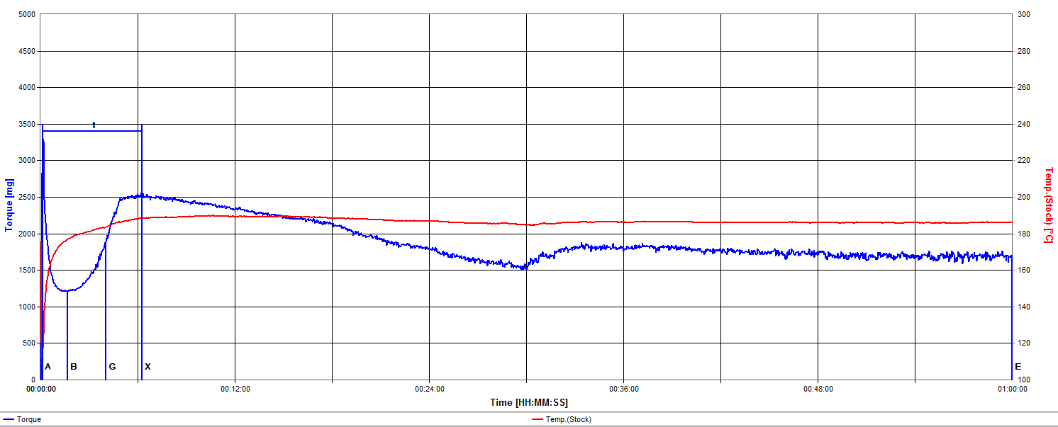
Rigid PVC – Higher Stabilizer
0.50 phr
0.25 phr

Slide 13
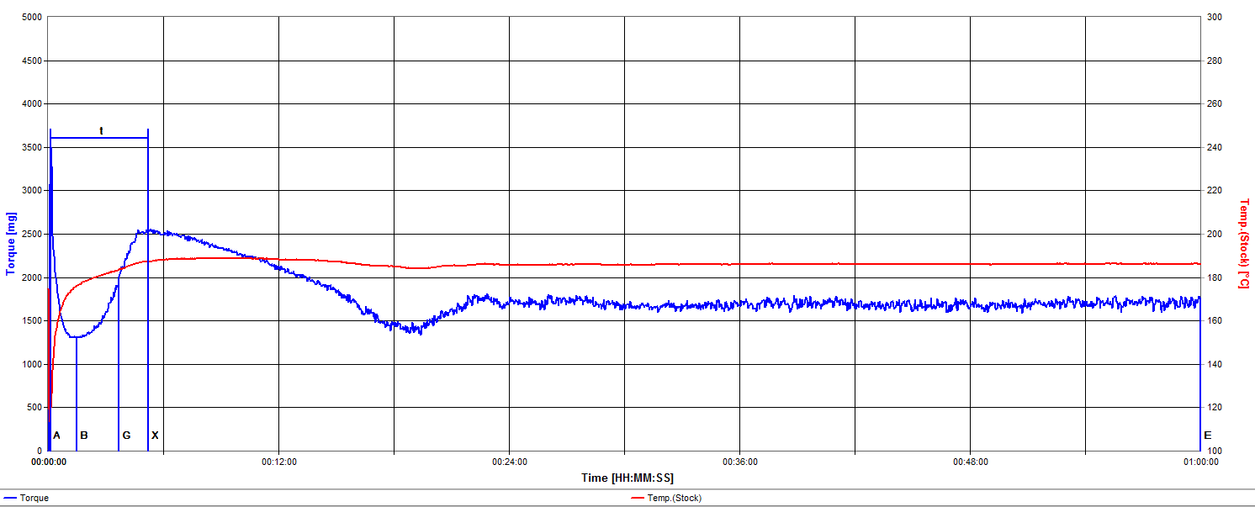
Rigid PVC – Lower Stabilizer
0.125 phr
0.0625 phr

Slide 14
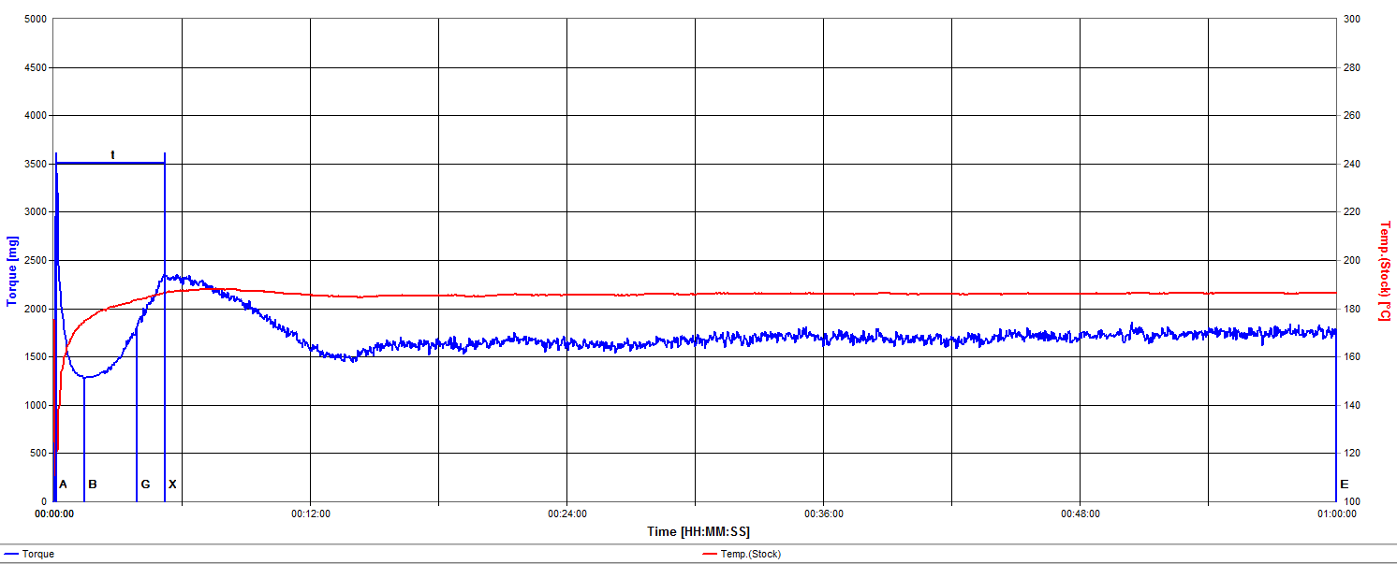
Rigid PVC – Lubricants Only
Zero Tin

Slide 15
Reducing Tin Stabilizer
Shifts rheology
Fusion time and torques remain remarkably similar
Post fusion torque decrease occurs quicker
Longer term melt torque and temperature remain remarkably stable
Melt exhibits more “chatter”

Slide 16
Mechanical Stabilization of Rigid PVC Color Development

Slide 17
Mechanical Stabilization of Rigid PVC Color Development
As the level of tin stabilizer is reduced, color develops more quickly.
When tin stabilizer is not present, early pinking becomes an issue.

Slide 18
Conclusions
In addition to their role in managing rheology, lubricants serve as mechanical stabilizers.
Rigid PVC free of conventional heat stabilizers may be processed under certain conditions.
Simple alkanes (paraffin waxes) are very versatile and effective primary lubricants for rigid PVC.

Slide 19
Conclusions
The paraffin wax, calcium stearate, and oxidized polyethylene wax long used in the USA is an excellent starting point for alternate stabilization systems.

Slide 20
Thank You!

