Slide 1
Lubrication and Mechanical Stabilization
of Rigid PVC Formulations
Thomas C. Pedersen
Rheogistics LLC
Picayune, MS USA

Slide 2
Typical Rigid PVC Pipe Formulation
PVC Resin
Tin Stabilizer
Lubricants
Calcium Carbonate
Pigments

Slide 3
Widely Used Rigid PVC Lubricants
Paraffin Waxes
Calcium Stearate
Polyethylene Waxes
Montan Waxes – the earliest standard
Hoechst Wax E & OP
Esters of Montanic acid
Fatty Acid Esters
Derived from natural oils and fats
Amide Waxes
Ethylene bisstearamide wax

Slide 4
Rigid PVC Lubricants
Prevent rigid PVC from degrading when heated and sheared.
Define rheology and control fusion.
Allow the compound to be adjusted to the process.
The keys to better rigid PVC products and processing.

Slide 5
Rigid PVC Lubricants
Paraffin waxes have been used for more than 40 years to lubricate rigid PVC.
Large volume rigid PVC applications using paraffin waxes as the primary lubricant include:
PVC Pipe
Vinyl Siding
Vinyl Windows
PVC Fencing
PVC Boards

Slide 6
Typical Rigid PVC Lubricant System
Paraffinic Hydrocarbon Wax
Refined from crude or synthetic based on ethylene or methane
Typical C₃₂H₆₆
Calcium Stearate
Calcium salt of acid from natural fats and oils
Ca(C₁₈H₃₅O₂)₂
Oxidized PE Wax
Ethylene based
C₁₀₀₊H₂₀₀₊O?

Slide 7
Rigid PVC Lubricants Product Options
Individual Ingredients
Combinations of multiple lubricants (Paraffin, oPE, etc.)
Total systems include paraffin, oPE, and calcium stearate
Dust free, free flowing, fully melting calcium stearate

Slide 8
Paraffin Waxes
Paraffin waxes are mixtures of branched and straight chain molecules
Normal Straight Chain Content
CH₃CH₂CH₂CH₂CH₂CH₂CH₂CH₂CH₂CH₂CH₂CH₂CH₂CH₂CH₂CH₂CH₂CH₂CH₂CH₂CH₂CH₂CH₂CH₂CH₂CH₂CH₂CH₂CH₂CH₂CH₂CH₃
Branched or “Non-normal” Content
CH₃
CH₃CH₂CH₂CH₂CH₂CH₂CH₂CH₁CH₂CH₂CH₂CH₂CH₂CH₂CH₂CH₂CH₂CH₂CH₂CH₁CH₂CH₂CH₂CH₂CH₂CH₂CH₂CH₃
CH₂
CH₂
CH₃
Over 1,000,000 different C₃₂₊ H₆₆₊ molecular structures are possible.

Slide 9
Effect of Wax Molecule Size on Rheology
Carbon Number | Fusion Time | Fusion Torque | Equil. Temp
26 | 166 sec | 21.3 Nm | >195°C.
32 | 352 sec | 15.2 Nm | 188°C.
40 | 2,120 sec | 10.1 Nm | 188°C.
100+ (PE Wax) | 182 sec | 18.9 Nm | >195°C.
C₂₆ more soluble in rigid PVC. C₄₀₊ insoluble in rigid PVC.

Slide 10
Lubricants are Mechanical Stabilizers
Lubricants prevent rigid PVC from degrading when heated and sheared.
Lubricants are often adjusted to eliminate shear burning issues.
In the USA, many rigid PVC formulations run very low levels of tin stabilizer and rely on lubrication for adequate stability.

Slide 11
Mechanical Stabilization of Rigid PVC
Recent Rheogistics Study
Could rigid PVC be processed without a conventional heat stabilizer? What happens when heat stabilizer is reduced and eliminated?

Slide 12
Mechanical Stabilization of Rigid PVC
Pipe Grade PVC Resin 100.0 parts
RX-165 Paraffin Lubricant 1.30 phr
RX-215 Oxidized Polyethylene 0.15 phr
Calcium Stearate 0.65 phr
Calcium Carbonate 5.00 phr
Titanium Dioxide 1.00 phr
19% Methyl Tin Stabilizer 0.50 phr, 0.25 phr, 0.125 phr,
0.0625 phr and zero
Processed on a Brabender Torque Rheometer for one hour (65 gram charge,
60 rpm, 175° set point, no cooling)

Slide 13
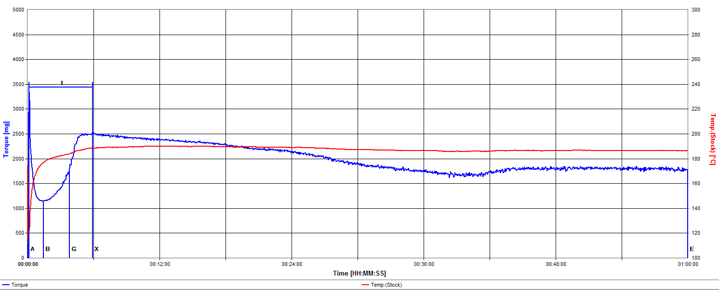
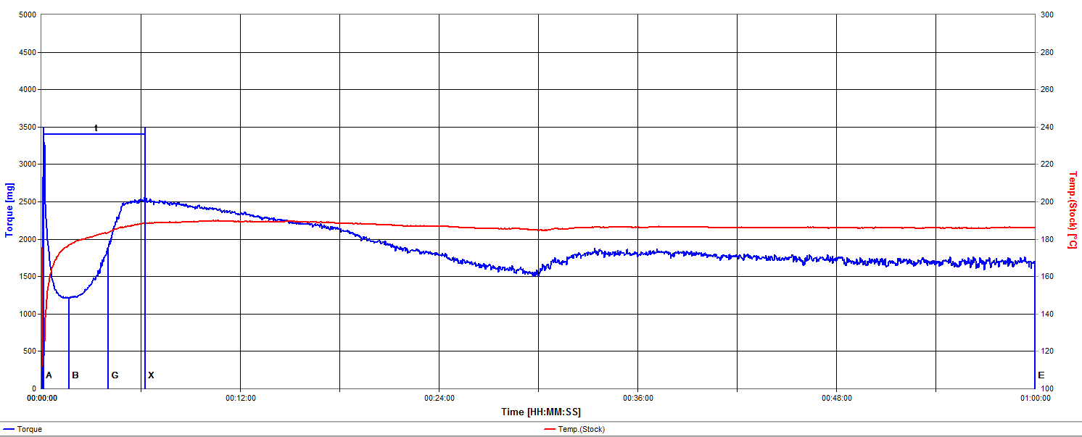
Rigid PVC – Higher Stabilizer
0.50 phr
0.25 phr

Slide 14
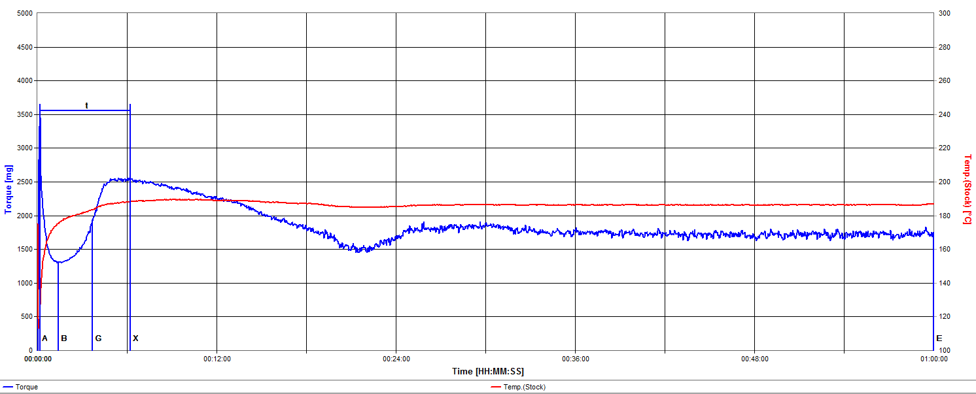
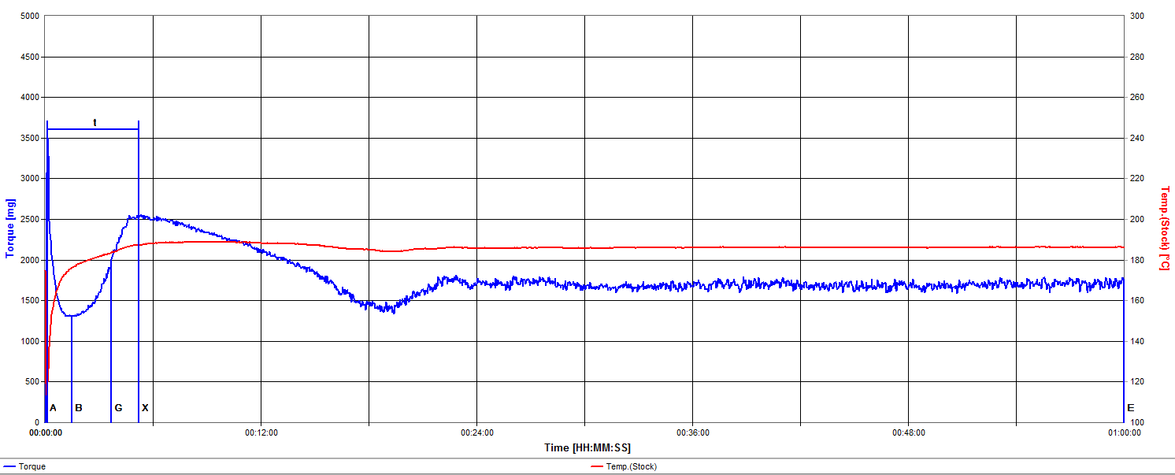
Rigid PVC – Lower Stabilizer
0.125 phr
0.0625 phr

Slide 15
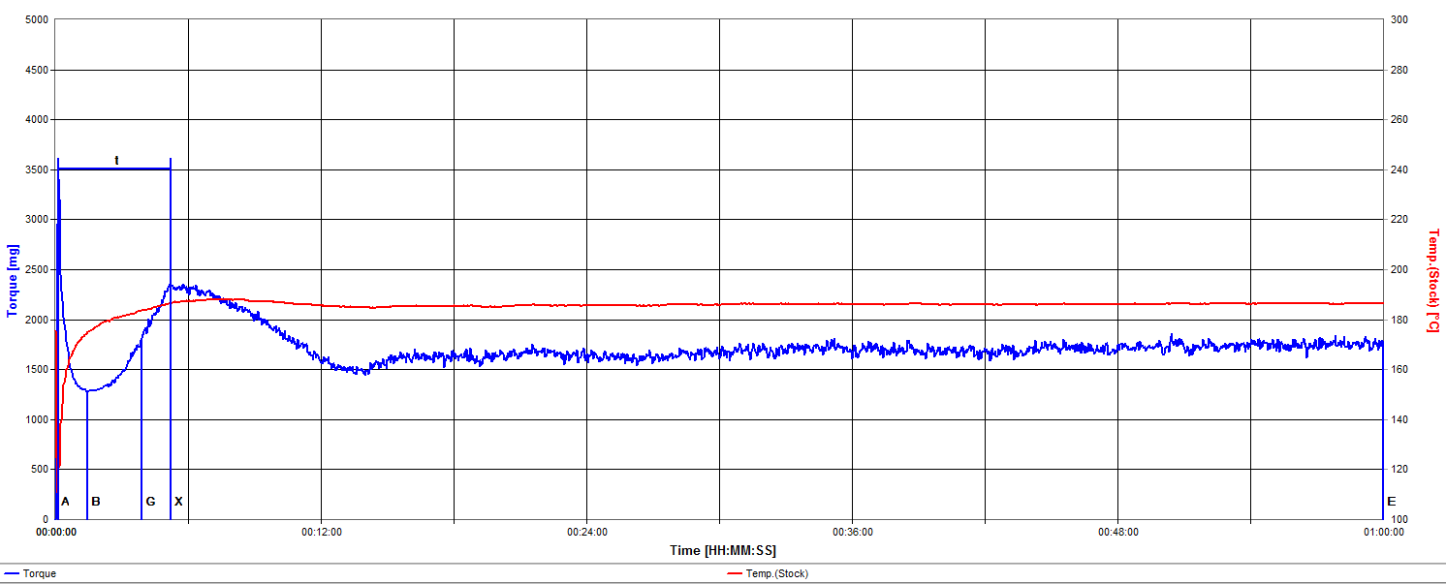
Rigid PVC – Lubricants Only
ZERO Tin

Slide 16
Reducing Tin Stabilizer
Shifts rheology
Fusion time and torques remain remarkably similar
Post fusion torque decrease occurs quicker
Longer term melt torque and temperature remain remarkably stable
Melt exhibits more “chatter”

Slide 17
Mechanical Stabilization of Rigid PVC Color Development

Slide 18
Mechanical Stabilization of Rigid PVC Color Development
As the level of tin stabilizer is reduced, color develops more quickly.
When tin stabilizer is not present, early pinking becomes an issue.

Slide 19
Post Fusion Torque
Why does the melt torque substantially decrease after fusion even as the melt temperature remains relatively stable?
“There’s something happening here, what it is ain’t exactly clear……”

Slide 20
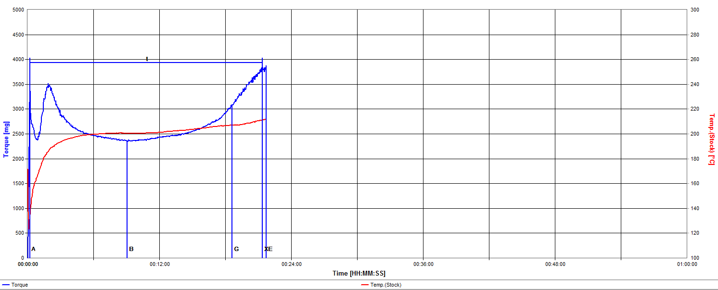
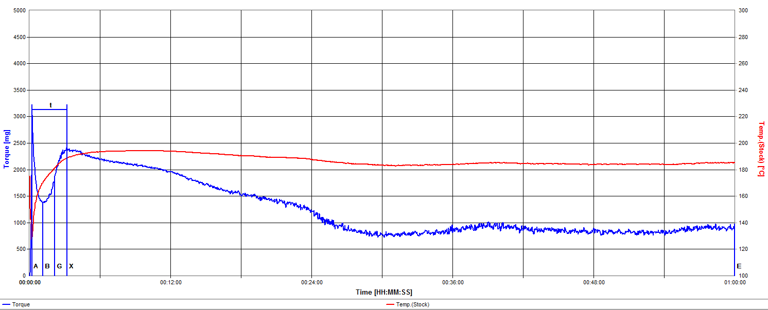
PPI PVC Pipe Range Composition Lubrication Limits
Minimum
Allowable
Lubricants,
0.60/0.00/0.40
Maximum Allowable
Lubricants,
1.50/0.30/1.50

Slide 21
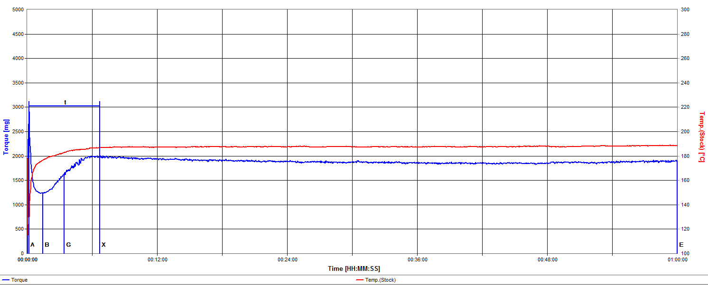
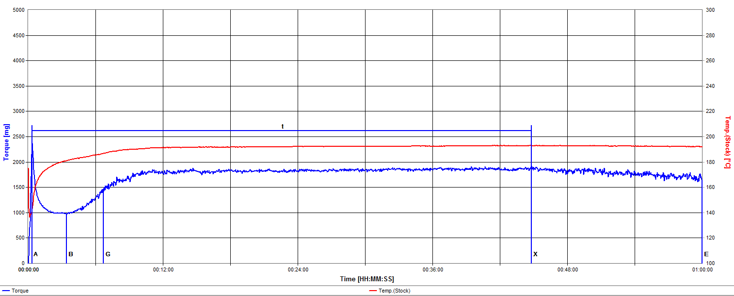
Ideal Post Fusion Torque Example RX-7 Calcium Stearate Free Formulation
Tin Stabilized
Mechanical Only

Slide 22
Conclusions
In addition to their role in managing rheology, lubricants serve as mechanical stabilizers.
Rigid PVC free of conventional heat stabilizers may be processed under certain conditions.
Simple alkanes (paraffin waxes) are very versatile and effective primary lubricants for rigid PVC.

Slide 23
Conclusions
The post fusion torque decrease often observed in rigid PVC formulations is related to a complex phenomena involving calcium stearate.
The paraffin wax, calcium stearate, and oxidized polyethylene wax long used in the USA is an excellent starting point for alternate stabilization systems.

Slide 24
Thank You!
Technology for Better Rigid PVC

