Slide 2
LW-16-18

Slide 3
Function of Waxes in
PVC Pipe Extrusion
Thomas C. Pedersen
Rheogistics LLC
Picayune, MS USA

Slide 4
Rigid PVC Lubricants
Paraffin waxes have been used for more than 40 years to lubricate rigid PVC.

Slide 5
Rigid PVC Lubricants
Paraffin Waxes
Calcium Stearate
Polyethylene Waxes
Montan Waxes – the earliest standard
Hoechst Wax E & OP
Esters of Montanic acid
Fatty Acid Esters
Derived from natural oils and fats
Amide Waxes
Ethylene bisstearamide wax

Slide 6
Rigid PVC Lubricants
Prevent rigid PVC from degrading when heated and sheared.
Define rheology and control fusion.
Allow the compound to be adjusted to the process.
The keys to better rigid PVC products and processing.

Slide 7
Rigid PVC
Most rigid PVC properties are affected in one way or another by the lubricant system.
Getting and keeping things right is a constant balancing act.

Slide 8
Poly Vinyl Chloride
Rigid PVC has great properties
Typical 7000+ psi tensile strength
Excellent stiffness
Excellent impact strength
Very good weatherability
Excellent cost performance

Slide 9
PVC Resin

Slide 10
PVC Compound

Slide 11
Processing Rigid PVC
Rigid PVC products are formed by heating and compressing PVC compounds into desired shapes.
The compound is compressed from a bulk density of approximately 0.50 gm/ml to a product density of approximately 1.40 gm/ml
PVC is heated to ca. 400°F by mechanical shear and heat transfer.
During processing, PVC is exposed to pressures of 2000 to 4000 psi.

Slide 12
PVC Processing
The 0.7-1 micron PVC primary particles are thought to be the primary flow units during rigid PVC processing

Slide 13
Rigid PVC Fusion in Extrusion

Slide 14
Effects of Fusion Levels on Physical Properties
Tensile Properties
Increase with increasing fusion
Impact Properties
Peak at an intermediate level of fusion

Slide 15
Extruder Energy Balance

Slide 16
Typical Rigid PVC Pipe Formulation
PVC Resin
Tin Stabilizer
Lubricants
Calcium Carbonate
Pigments

Slide 17
Plastic Pipe Institute’s TR-2 PVC Pipe Formulation
Ingredient Usage Level
PVC Resin 100.0 parts
Tin Stabilizer 0.30 – 1.00 phr
Paraffin Wax 0.60 – 1.50 phr
Polyethylene Wax 0.00 – 0.30 phr
Calcium Stearate 0.40 – 1.50 phr
Calcium Carbonate 0.00 – 5.00 phr
Titanium Dioxide 0.50 – 3.00 phr
Process Aid 0.00 – 2.00 phr

Slide 18
Typical Rigid PVC Lubricant System
Paraffinic Hydrocarbon Wax
Refined from crude or synthetic based on ethylene or methane
Typical C₃₂H₆₆
Calcium Stearate
Calcium salt of acid from natural fats and oils
Ca(C₁₈H₃₅O₂)₂
Oxidized PE Wax
Ethylene based
C₁₀₀₊H₂₀₀₊O?

Slide 19
Plastic Pipe Institute TR-2 Part A.3 Paraffinic Hydrocarbon Wax Specification

Slide 20
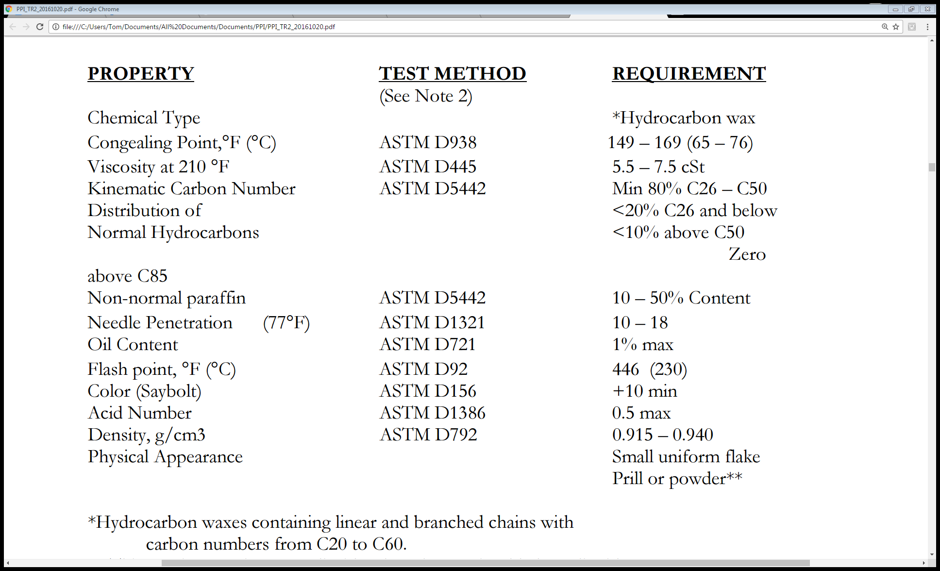

Slide 21
Formulating waxes to meet
the PPI specification will result in rigid PVC formulations with different processing characteristics and physical properties.

Slide 22
If formulating waxes for rigid PVC, keep in mind what Mark Twain said:
“It ain't what you don't know that gets you into trouble. It's what you know for sure that just ain't so.”

Slide 23
The only reliable predictor of hydrocarbon wax performance in rigid PVC:
The size, shape, and numbers of wax molecules.

Slide 24
Typical Rigid PVC Lubricant System
Paraffinic Hydrocarbon Wax
Refined from crude or synthetic based on ethylene or methane
Typical C₃₂H₆₆
Calcium Stearate
Calcium salt of acid from natural fats and oils
Ca(C₁₈H₃₅O₂)₂
Oxidized PE Wax
Ethylene based
C₁₀₀₊H₂₀₀₊O?

Slide 25
Rigid PVC Lubricants Product Options
Individual Ingredients
Combinations of multiple lubricants (Paraffin, oPE, etc.)
Total systems include paraffin, oPE, and calcium stearate
Dust free, free flowing, fully melting calcium stearate

Slide 26
Fusion Characterization in the Lab
Torque Rheometer
Fixed volume heated chamber
Work imparted into PVC compound by mixing blades
Measure torque required to turn the blades and melt temperature

Slide 27
Trial PVC Compound
PVC Resin 100 parts
Stabilizer 0.50 phr
Wax 1.30 phr
Calcium Stearate 0.65 phr
Oxidized PE Wax 0.15 phr
Calcium Carbonate 5.00 phr
Titanium Dioxide 0.50 phr

Slide 28
Paraffin Waxes
Paraffin waxes are mixtures of branched and straight chain molecules
Normal Straight Chain Content
CH₃CH₂CH₂CH₂CH₂CH₂CH₂CH₂CH₂CH₂CH₂CH₂CH₂CH₂CH₂CH₂CH₂CH₂CH₂CH₂CH₂CH₂CH₂CH₂CH₂CH₂CH₂CH₂CH₂CH₂CH₂CH₃
Branched or “Non-normal” Content
CH₃
CH₃CH₂CH₂CH₂CH₂CH₂CH₂CH₁CH₂CH₂CH₂CH₂CH₂CH₂CH₂CH₂CH₂CH₂CH₂CH₁CH₂CH₂CH₂CH₂CH₂CH₂CH₂CH₃
CH₂
CH₂
CH₃
Over 1,000,000 different C₃₂₊ H₆₆₊ molecular structures are possible.

Slide 29
Effect of Wax Molecule Size on Rheology
Carbon Number | Fusion Time | Fusion Torque | Equil. Temp
26 | 166 sec | 21.3 Nm | >195°C.
32 | 352 sec | 15.2 Nm | 188°C.
40 | 2,120 sec | 10.1 Nm | 188°C.
100+ (PE Wax) | 182 sec | 18.9 Nm | >195°C.
C₂₆ more soluble in rigid PVC. C₄₀₊ insoluble in rigid PVC.

Slide 32
Lubricants are Mechanical Stabilizers
Lubricants prevent rigid PVC from degrading when heated and sheared.
Lubricants are often adjusted to eliminate shear burning issues.
In the USA, many rigid PVC formulations run very low levels of tin stabilizer and rely on lubrication for adequate stability.

Slide 33
Mechanical Stabilization of Rigid PVC
Recent Rheogistics Study
Could rigid PVC be processed without a conventional heat stabilizer? What happens when heat stabilizer is reduced or eliminated?

Slide 34
Plastic Pipe Institute’s TR-2 PVC Pipe Formulation
Ingredient Usage Level
PVC Resin 100.0 parts
Tin Stabilizer 0.30 – 1.00 phr
Paraffin Wax 0.60 – 1.50 phr
Polyethylene Wax 0.00 – 0.30 phr
Calcium Stearate 0.40 – 1.50 phr
Calcium Carbonate 0.00 – 5.00 phr
Titanium Dioxide 0.50 – 3.00 phr
Process Aid 0.00 – 2.00 phr

Slide 35
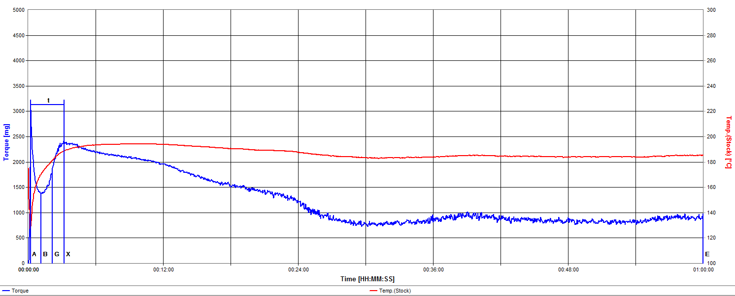
PPI PVC Pipe Range Composition Lubrication Limits
Minimum
Allowable
Lubricants,
0.60/0.00/0.40
Maximum Allowable
Lubricants,
1.50/0.30/1.50

Slide 36
Mechanical Stabilization of Rigid PVC
Pipe Grade PVC Resin 100.0 parts
RX-165 Paraffin Lubricant 1.30 phr
RX-215 Oxidized Polyethylene 0.15 phr
Calcium Stearate 0.65 phr
Calcium Carbonate 5.00 phr
Titanium Dioxide 1.00 phr
19% Methyl Tin Stabilizer 0.50 phr, 0.25 phr, 0.125 phr,
0.0625 phr and zero
Processed on a Brabender Torque Rheometer for one hour (65 gram charge,
60 rpm, 175° set point, no cooling)

Slide 37
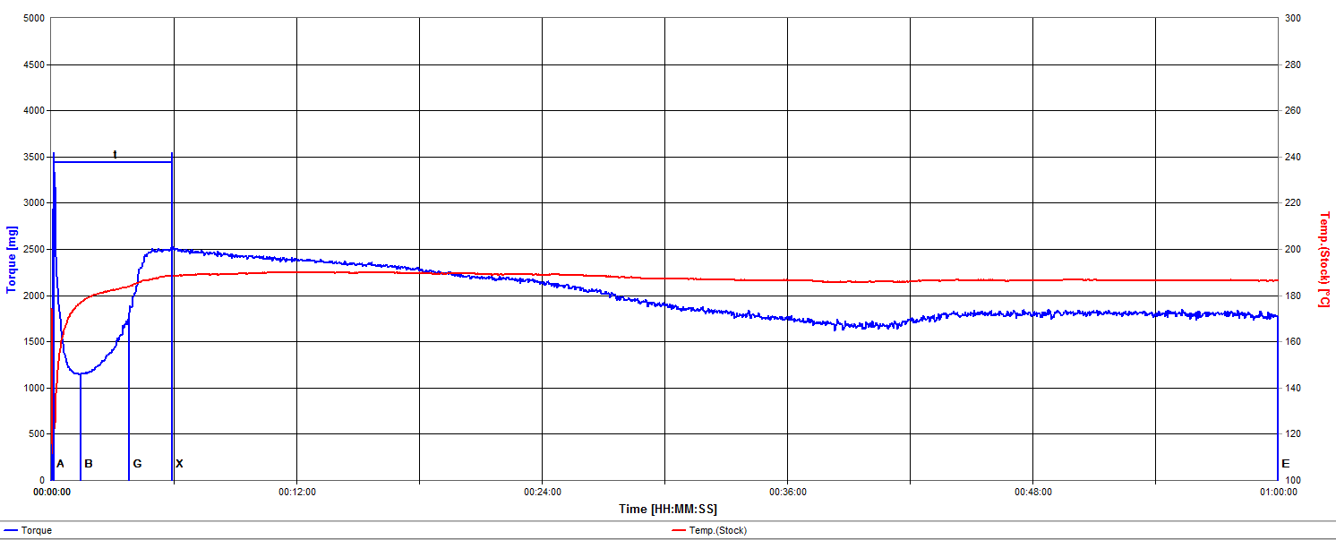
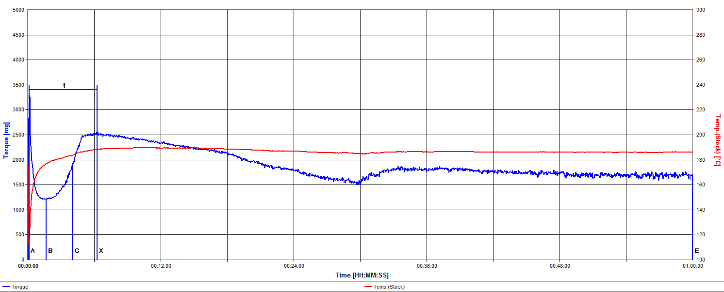
Rigid PVC – Higher Stabilizer
0.50 phr
0.25 phr

Slide 38
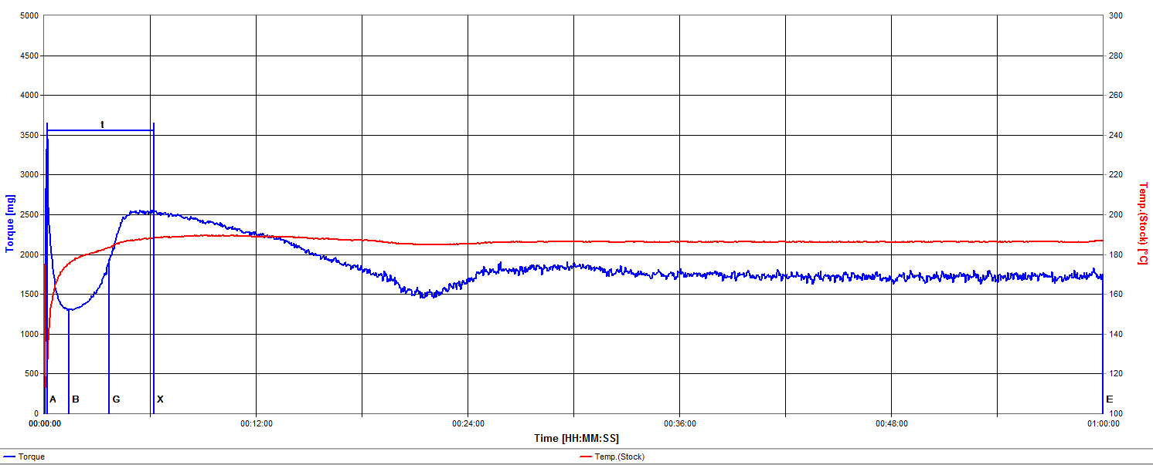
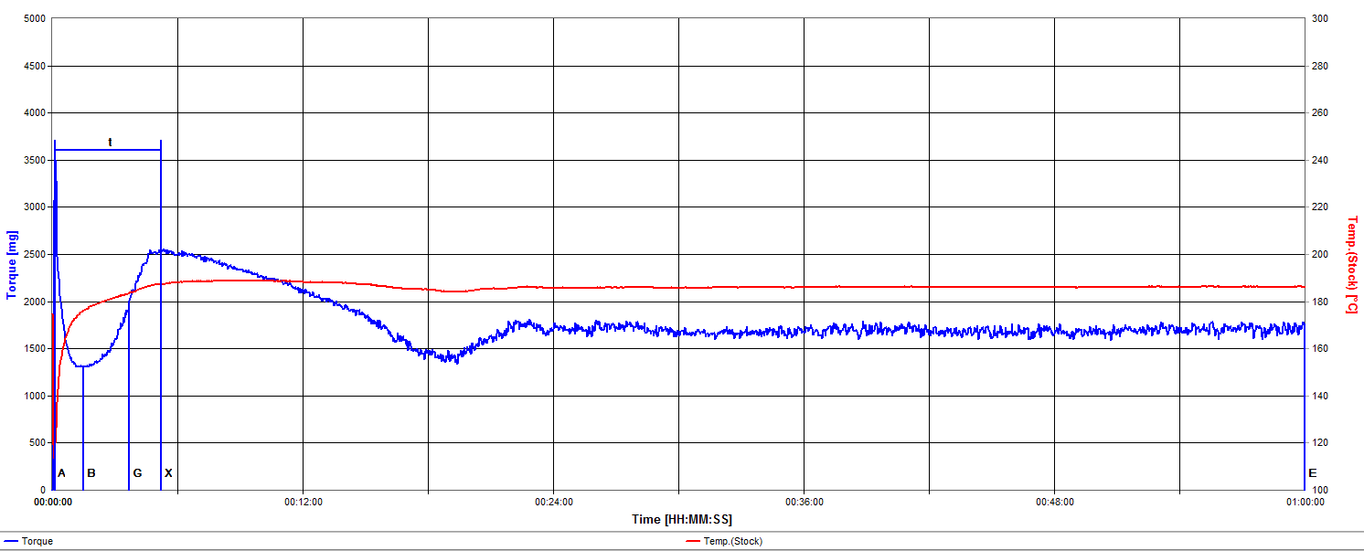
Rigid PVC – Lower Stabilizer
0.125 phr
0.0625 phr

Slide 39
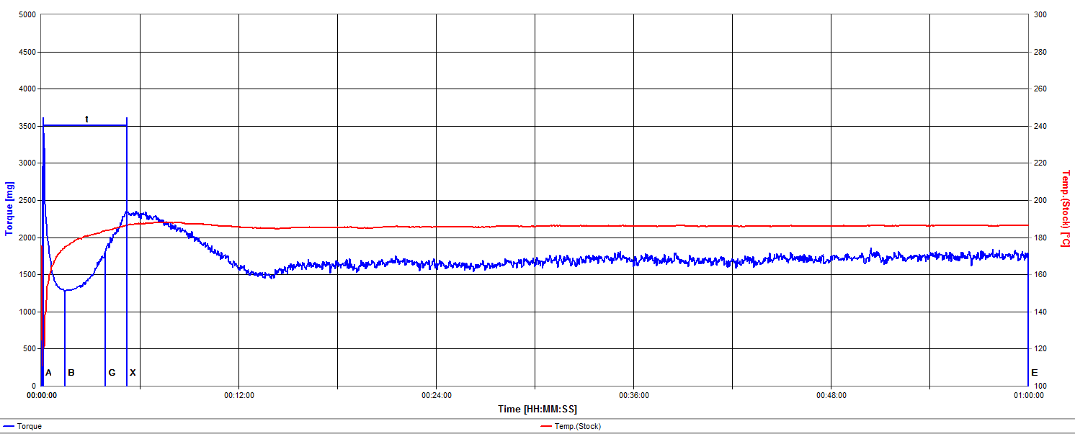
Rigid PVC – Lubricants Only
ZERO Tin

Slide 40
Reducing Tin Stabilizer
Shifts rheology
Fusion time and torques remain remarkably similar
Post fusion torque decrease occurs quicker
Longer term melt torque and temperature remain remarkably stable
Melt exhibits more “chatter”

Slide 41
Mechanical Stabilization of Rigid PVC Color Development

Slide 42
Mechanical Stabilization of Rigid PVC Color Development
As the level of tin stabilizer is reduced, color develops more quickly.
When tin stabilizer is not present, early pinking becomes an issue.

Slide 43
Conclusions
The PVC Industry is a large application for paraffin and hydrocarbon waxes.
Simple alkanes (paraffin waxes) are very versatile and effective primary lubricants for rigid PVC.

Slide 44
Conclusions
Waxes with carbon numbers of C30 to C34 work best as primary PVC lubricants in North America’s tin stabilized formulations.
In addition to their role in managing rheology, lubricants serve as mechanical stabilizers.
Rigid PVC free of conventional heat stabilizers may be processed under certain conditions.

Slide 45
Conclusions
The lubricant system is adjusted to tune the formulation to the heating and shearing characteristics of the customer’s processing equipment.
Changes in any material or any piece of equipment in a customer’s plant results in the need for a lubricant adjustment.

Slide 46
Conclusions
Understanding and managing lubricant performance in rigid PVC is very complex.
The PVC industry requires in-depth technical support and service.

Slide 47
Conclusions
The paraffin wax, calcium stearate, and oxidized polyethylene wax long used in the USA is an excellent starting point for alternate stabilization systems.

Slide 48
References
T. C. Pedersen, “Process and Material Considerations in the Industrial Application of Lubricants in Rigid PVC Extrusion”, Journal of Vinyl Technology, 6, 104 (1984)
J. W. Summers, “Lubrication Mechanism in Poly (Vinyl Chloride) Compounds: Understanding the Three Distinct Roles of Lubricants” Antec 2006, Society of Plastics Engineers.
P. Benjamin, “The Influence of Processing on the Properties of PVC Pipe”, International Conference on PVC Processing, 6 & 7 April 1978, The Plastics and Rubber Institute.
TR-2, Plastic Pipe Institute PVC Pipe Range Composition, List of Qualified Ingredients, 19 March 2013, Plastics Pipe Institute, Irving, TX USA

Slide 49
Thank You!
Technology for Better Rigid PVC

